Slide 1
Designer Drug Database Student: Carlos Dominguez Mentor: Dr. Luis Arroyo
Project Plan
CIS 4911 Senior Project
School of Computing and Information Sciences
Florida International University
2/2/2015

Slide 2
My Role
Role: Developer, Scrum Master In this project I am in charge of
development and documentation
Artifacts: Authentication system, database, API, ResponsiveWeb Design SPA.

Slide 3
My Plan
Starting today my plan is to create in the first spring a working system. Then I could add on all extra required features
Plan B:
If project proposal do not go through then I will change the approach and adjust to another option within the feasible study.

Slide 4
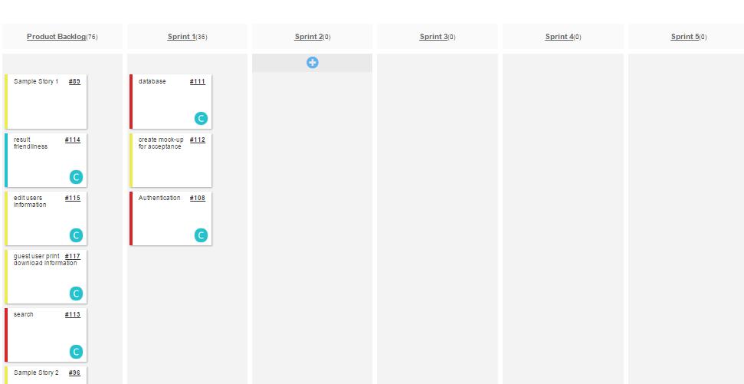
Sprint Planning

Slide 5
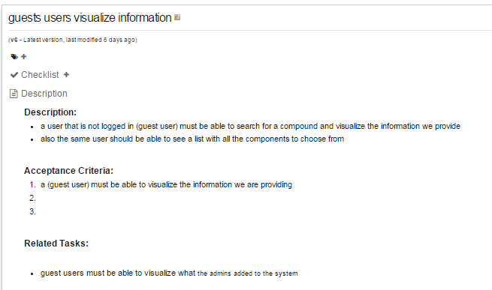
User Story

Slide 6
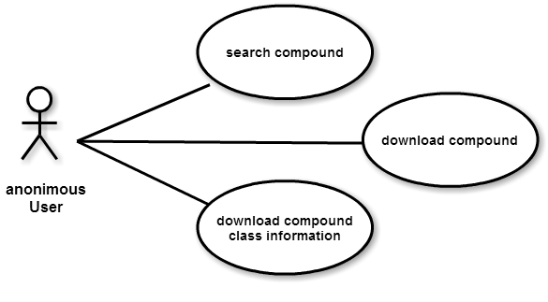
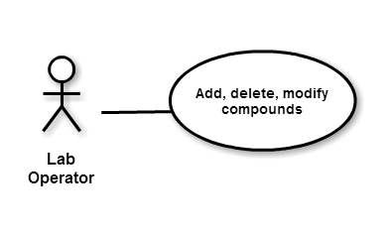
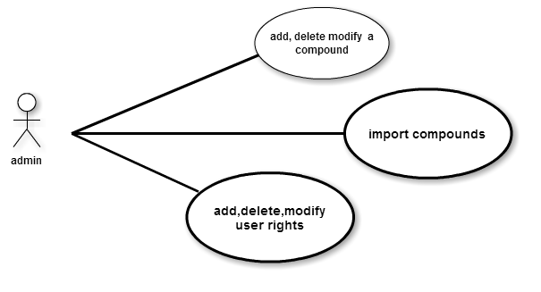
High level Use Cases

Slide 7
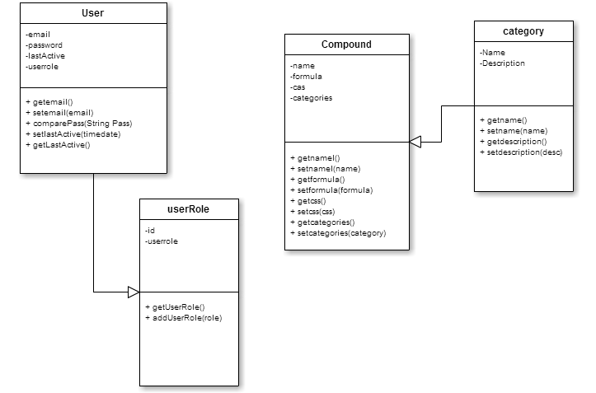
Class diagrams

Slide 8
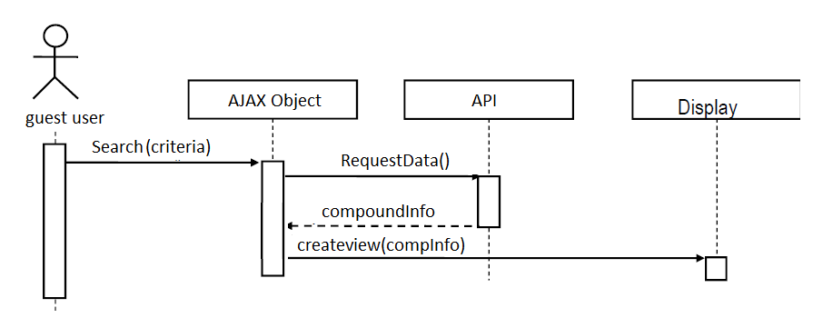
Sequence diagram

Slide 9
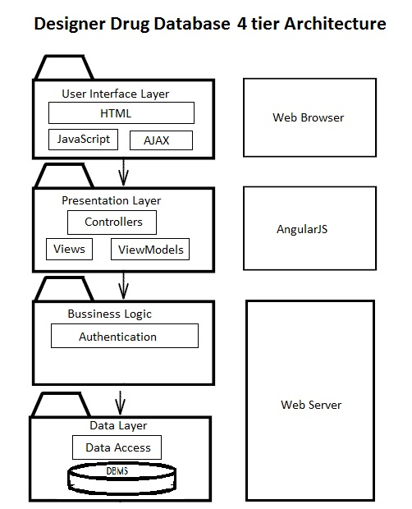
Overview

Slide 10
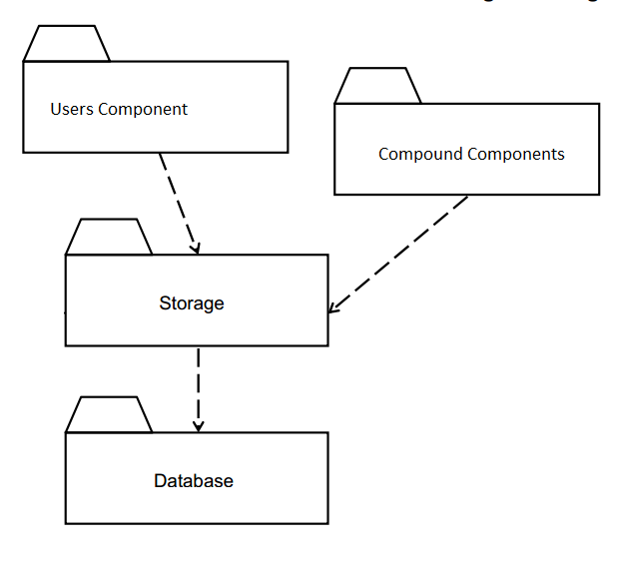
Subsystem decomposition

Slide 11
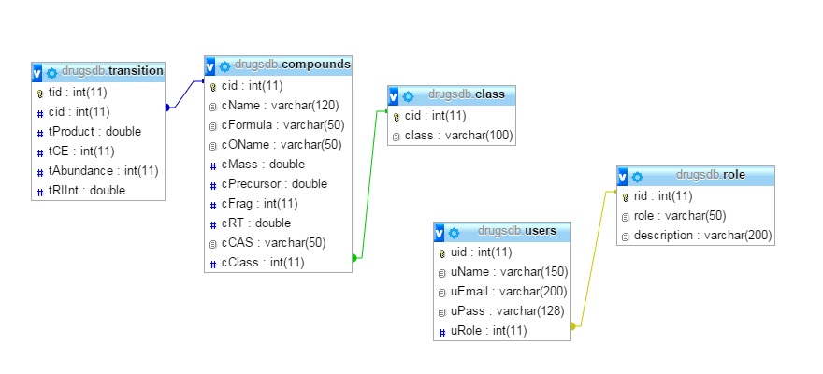
Persistent Data Management

Slide 12
Security and privacy
Data security: pdo
Password security : md5 encryption.
To keep state: sesions

Slide 13
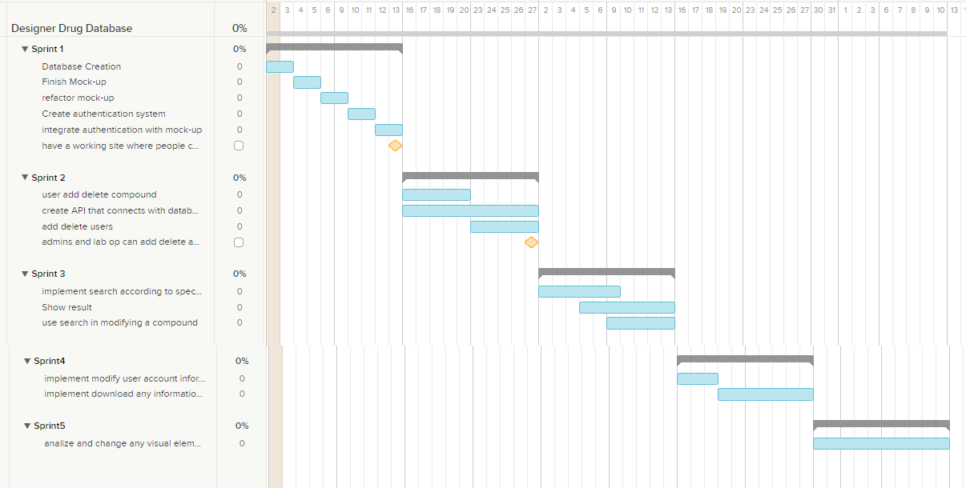
Grantt Chart

Slide 14
DEMO TIME

